Slide 1
Brand Extension II

Slide 2
Overview
When are category extensions successful?
“Fit” is instrumental in extension success
Bases of fit
Evaluating extension opportunities

Slide 3
Examples of Category Extensions
“SUCCESSFUL” CATEGORY EXTENSIONS
Sunkist Vitamin C tabs
Tide to Go pens
Snickers ice cream bars
Planter’s peanut butter
Coleman sleeping bags
Colgate toothbrushes
Starbucks energy drinks
“UNSUCCESSFUL” CATEGORY EXTENSIONS
Life Savers soda
Bic underwear
Colgate Kitchen Entrees
Dr. Pepper BBQ sauce
Arm & Hammer underarm
Cheetos lip balm
Evian water bras

Slide 4

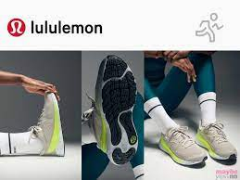
Examples of Category Extensions (2)

Slide 5
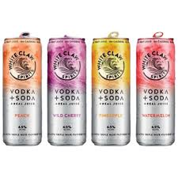
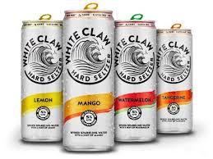
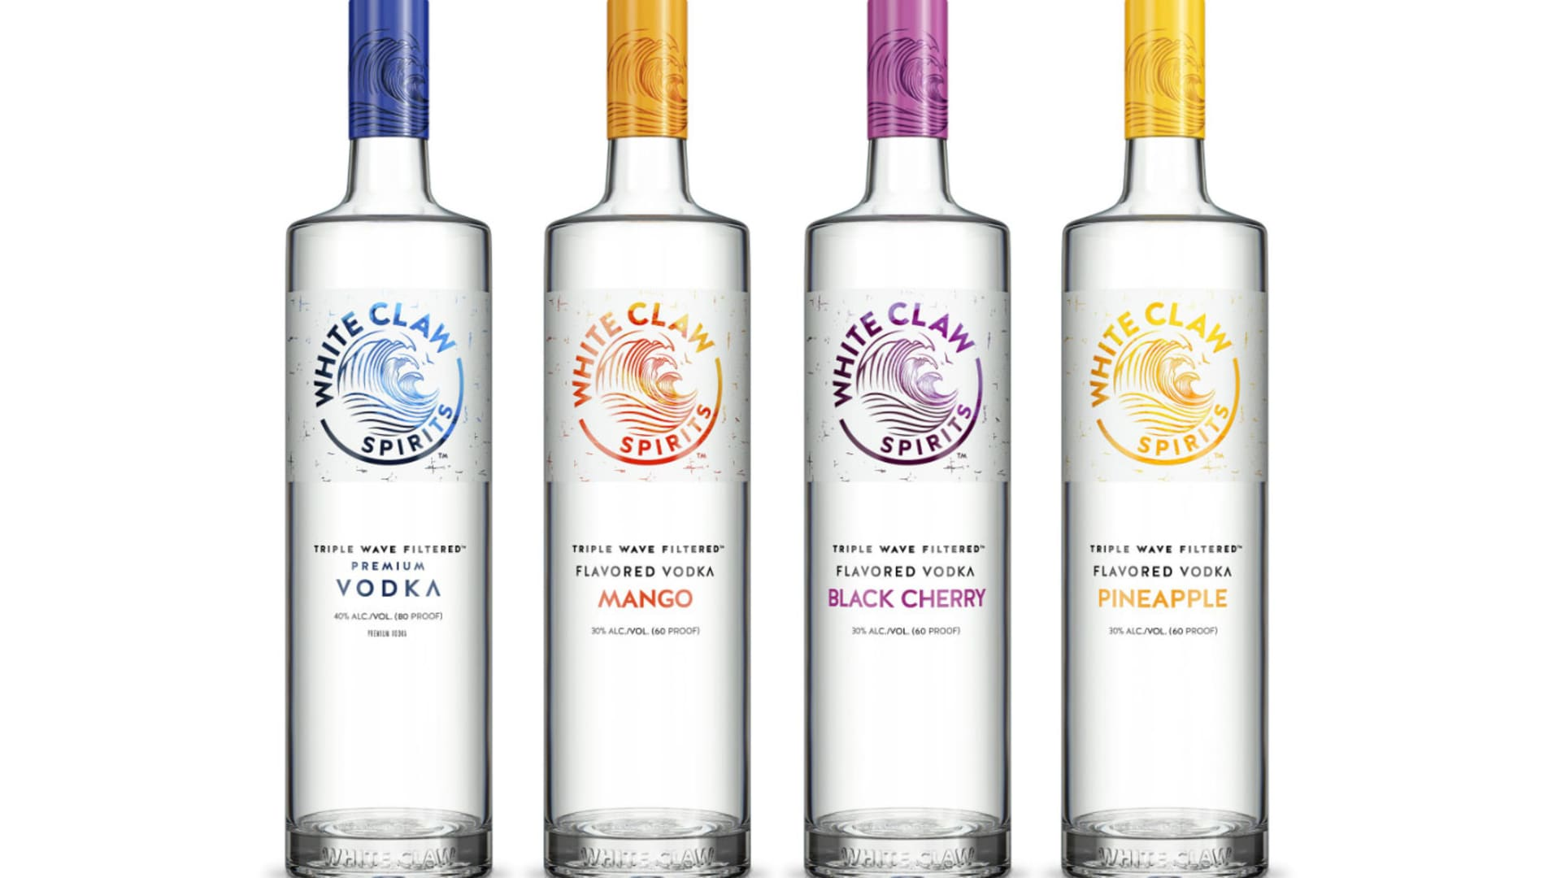
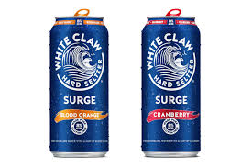
Examples of Category Extensions (3)

Slide 6
When are Extensions Most Successful?
Parent brand possesses strong favorable associations and there is a strong “fit” between the parent and the extension category.

Slide 7
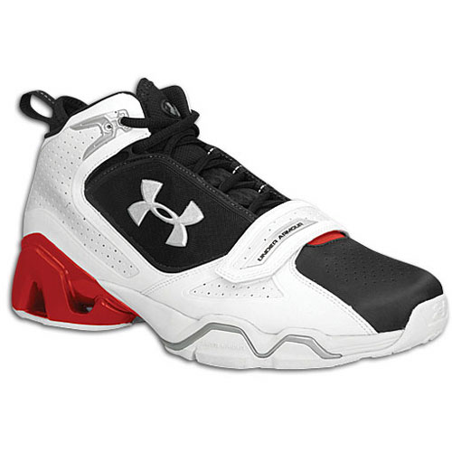
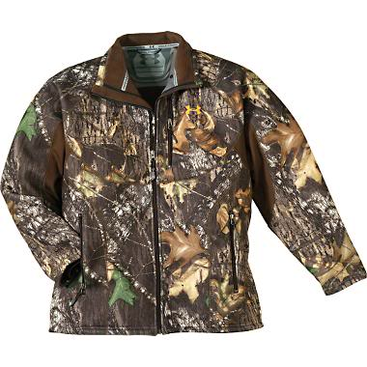
Bases of “Fit”
Shared skills/assets
Product complementarity
Utilitarian benefits
Prestige image

Slide 8
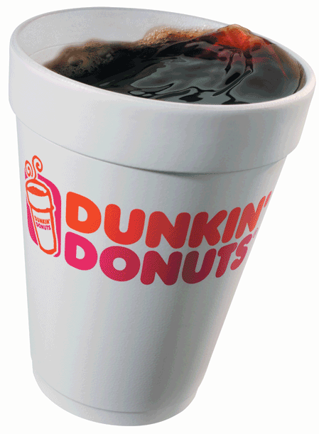
Bases of “Fit” (2)
Shared skills/assets
Product complementarity
Utilitarian benefits
Prestige image

Slide 9
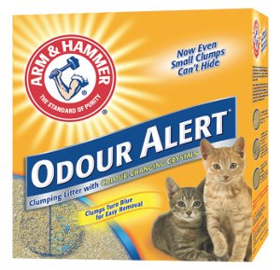
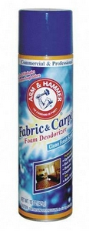
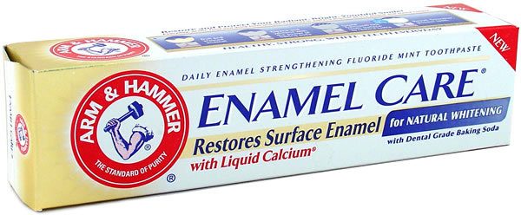
Bases of “Fit” (3)
Shared skills/assets
Product complementarity
Utilitarian benefits
Prestige image

Slide 10
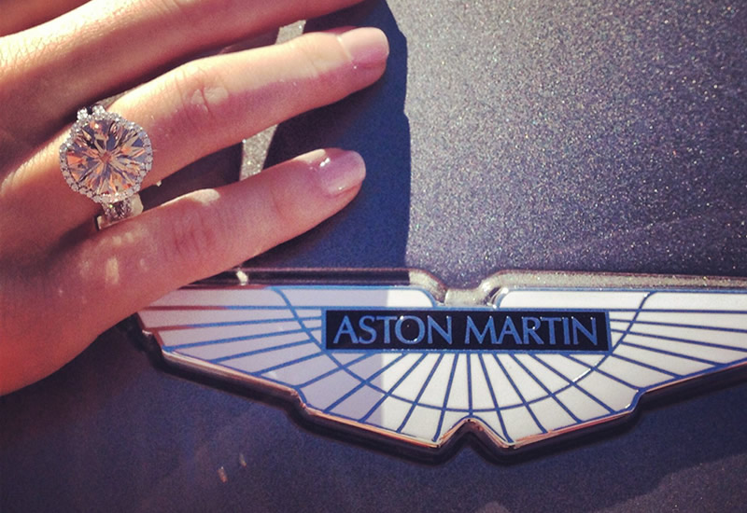

Bases of “Fit” (4)
Shared skills/assets
Product complementarity
Utilitarian benefits
Prestige image

Slide 11
Beyond Fit: Extension Authenticity
Brand Extension Authenticity (BEA) refers to the consumer’s sense that a brand extension is a legitimate, culturally consistent extension of the parent brand.
BEA is comprised of four inter-related dimensions that can be assessed for any existing or proposed brand extension by asking consumers to respond to a series of rating scales.

Slide 12
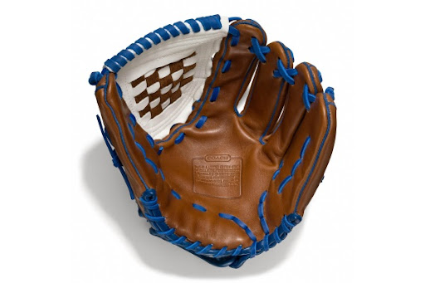
Beyond Fit: Extension Authenticity (2)
Maintaining brand style and standards
  (“This extension appears to be inferior to ______.”)
Honoring brand heritage
  (“______ seems to have abandoned it roots with this extension.”)
Preserving brand essence
  (“What makes ______ distinct to me is lost in this extension.”)
Avoiding brand exploitation
  (“This extension likely trades off the essence of ______ strictly for profit.”)

Slide 13
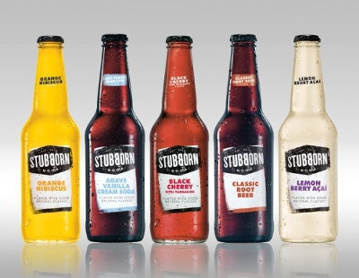
Eschewing Brand Extension
From Pepsi…

Slide 14
Other Findings…
High quality parent brands extend “further” than average quality parent brands.
More “abstract” parent brand associations are easier to extend than are “concrete” associations.
A successful extension creates the potential for even further extensions of the parent brand.
An unsuccessful extension is most damaging when there is a strong fit between the parent and the extension.

Slide 15
More Findings…
Extensions are most successful when the parent brand enjoys a high degree of brand loyalty.
Vertical extensions are difficult and may require sub-branding.
Strong marketing support at launch is critical to an extension’s success.
Retailer acceptance is critical to extension success.

Slide 16
The Brand Extension Decision Process
Fully research parent brand equity (esp. associations)
Determine extension category(ies) potential
Evaluate transferability and relevance of brand assets to extension category
Assessment of superiority of extension to competition
Assessment of company resources to sustain competition
Develop and execute launch strategy
Evaluate extension success and feedback effect on parent

Slide 17
Conclusion
Has your organization attempted any line or category extensions?
If so, were they successful?
Why or why not?

Slide 18
End of Lecture

